Slide 1

Spatiotemporal Video-Based Human Action
Recognition with Voice Feedback
Bhavaa Dharshini - 20MIS1031
Guide - Dr.Kanthimathi S

Slide 2
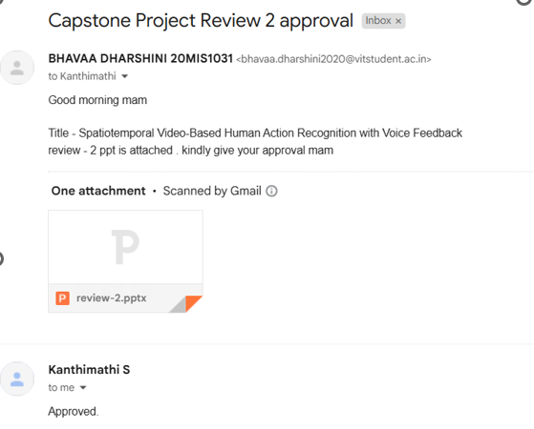

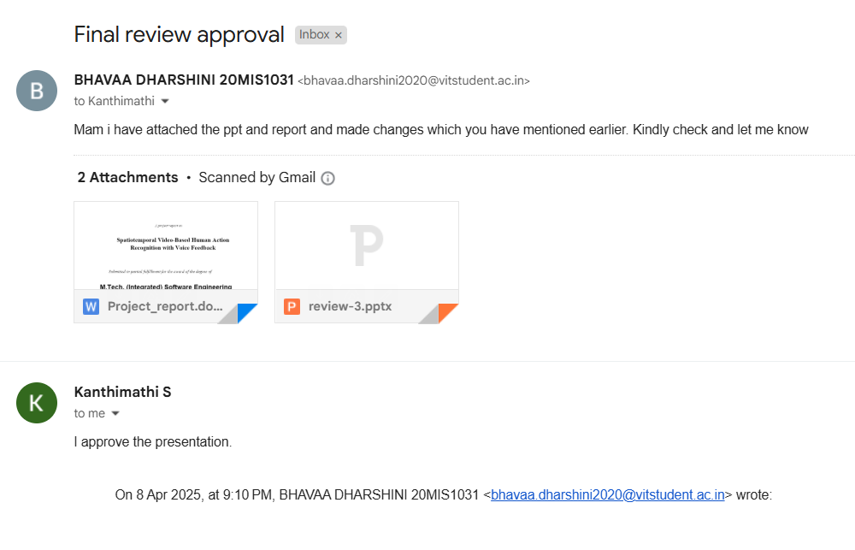
Guide Approval:

Slide 3
Objectives
The primary objective of this project is to develop a Human Action Recognition (HAR) system that assists visually impaired individuals by providing real-time feedback about human actions around them.
Specific Objectives:
Detect and classify 15 common human actions (e.g., running, sleeping, cycling, listening to music).
Leverage Graph Neural Networks (GNNs) for accurate and efficient action recognition.
Provide auditory or haptic feedback to the user in real-time.
Design a system optimized for real-world use in varied environments.

Slide 4
Literature Survey
Author | Title | Summary | Findings
1. Stefania Cristina; Vladimir Despotovic; Rodrigo Pérez-Rodríguez; Slavisa Aleksic | Audio- and Video-Based Human Activity Recognition Systems in Healthcare January 2024 IEEE Access ( Volume: 12) | Human activity recognition (HAR) has gained significance in healthcare, with audio- and video-based systems being applied for smart living and healthcare services. This review covers system performance, challenges, and future trends in integrating HAR for real-world healthcare applications. | Gaps in HAR for healthcare include limited audio-based approaches, complex multimodal systems, and challenges with real-world data and efficient learning models.
2. Wei Lin;Xiaoyu Liu;Yihong Zhuang;Xinghao Ding;Xiaotong Tu;Yue Huang;Huanqiang Zeng | Unsupervised Video-Based Action Recognition With Imagining Motion and Perceiving Appearance Year: 2023 | Volume: 33, Issue: 5 | Journal Article | Publisher: IEEE | IMPA is an unsupervised video-based action recognition model that extracts motion and appearance features using self-supervised Motion Extracting Block (MEB) and Appearance Learning Block (ALB) for improved recognition. | Its effectiveness in complex real-world scenarios and generalization across diverse video datasets need further exploration.

Slide 5
Literature Survey
Author | Title | Summary | Findings
3. Hongwei Yin, Richard O. Sinnott & Glenn T. Jayaputera | A survey of video-based human action recognition in team sports Published: 16 September 2024 Volume 57, article number 293, (2024) | This paper reviews human action recognition (HAR) in team sports like football, basketball, and Australian rules football, highlighting key datasets, challenges, and future research directions. It emphasizes the unique challenges of HAR in team sports, which involve faster-paced actions and more human-human interactions. | The gaps include limited focus on HAR for fast-paced team sports, a lack of specialized datasets, and challenges in real-time performance and scalability.
4. Pranjal Kumar, Siddhartha Chauhan & Lalit Kumar Awasthi | Human Activity Recognition (HAR) Using Deep Learning: Review, Methodologies, Progress and Future Research Directions 12 August 2023 Volume 31, pages 179–219, (2024) | This survey explores deep learning advancements in human activity recognition (HAR) across video and sensor modalities, covering applications in healthcare, emotion detection, assisted living, and security. It analyzes key works, performance metrics, challenges, and proposes future research directions in HAR. | The gap in this paper lies in addressing the challenges of real-time HAR implementation, particularly in dynamic and diverse environments, and the lack of large, high-quality datasets for specific applications like emotion detection and assisted living. Additionally, the integration of multi-modal data for more accurate recognition remains underexplored.

Slide 6
Literature Survey
Author | Title | Summary | Findings
5. Wen Qi; Xiangmin Xu; Kun Qian; Björn W. Schuller; Giancarlo Fortino; Andrea Aliverti | A Review of AIoT-based Human Activity Recognition: From Application to Technique 29 May 2024 IEEE, Page(s): 1 - 14 | This paper explores AIoT-driven Human Activity Recognition (HAR), proposing adaptive models with multimodal data fusion for behavior prediction. It highlights benchmarks, integration paradigms, and research directions, focusing on real-time recognition, data security, and privacy. | The work lacks exploration of scalable real-time HAR systems, comprehensive datasets for diverse applications, and robust solutions for addressing interoperability and privacy challenges in AIoT-driven HAR.
6. Rahul Kumar, Shailender Kumar | A survey on intelligent human action recognition techniques Volume 83, pages 52653–52709, (2024) | This study reviews Human Action Recognition (HAR) advancements from 2010 to 2022, comparing ML and DL techniques, highlighting datasets, and discussing challenges, limitations, and future research directions in HAR methods and applications. | The study lacks exploration of real-time HAR in dynamic environments, robust hybrid models integrating ML and DL, and solutions for addressing dataset diversity and scalability challenges

Slide 7
Literature Survey
Author | Title | Summary | Findings
7. Geetanjali Bhola & Dinesh Kumar Vishwakarma | A review of vision-based indoor HAR: state-of-the-art, challenges, and future prospects Volume 83, pages 1965–2005, (2024) | This study surveys Indoor Human Activity Recognition (HAR), exploring its applications in smart homes, elderly care, and abnormal activity detection. It reviews methodologies, challenges, datasets, and proposes a taxonomy while highlighting future prospects and research gaps. | The study lacks solutions for real-time indoor HAR in diverse environments, addressing issues like privacy, occlusions, and robust datasets for abnormal activity detection.
8. Mukhiddin Toshpulatov; Wookey Lee; Suan Lee; Hoyoung Yoon; U Kang | DDC3N: Doppler-Driven Convolutional 3D Network for Human Action Recognition 03 July 2024, IEEE, Page(s): 93546 - 93567 | This study examines challenges in DL-based HAR for sports, focusing on dataset scarcity, camera variability, and occlusions. It introduces two curated datasets, evaluates 3DCNNs versus GCNs, and proposes resource-efficient methods to enhance HAR accuracy and efficiency in surveillance scenarios. | The study lacks exploration of real-time solutions for dynamic sports environments, integration of multimodal data, and scalable approaches to address computational overhead in large-scale HAR systems.

Slide 8
Literature Survey
Author | Title | Summary | Findings
9. Vivek Pandey; Tanishka Gulvi; Samirkumar Waghmare; Prasad Dalvi; Rohit Kesarkar; Deepanshu Dayal | To Build and Evaluate Irregular Human Activity Detection System Using Deep CNN-LSTM Methodology 12 November 2024, IEEE, 27-28 September 2024 | This study integrates CNNs and LSTMs for irregular activity detection in surveillance systems, using the UCF Crime dataset. It preprocesses video frames, extracts discriminative features, and captures temporal dependencies to achieve high accuracy in identifying abnormal behaviors like rapid movements and object interactions. | The study lacks exploration of real-time deployment for large-scale surveillance and robust handling of diverse environmental conditions like lighting, occlusions, and noise in video data.
10. Shengqin Jiang; Haokui Zhang; Yuankai Qi; Qingshan Liu | Spatial-Temporal Interleaved Network for Efficient Action Recognition 26 September 2024, EEE, Page(s): 178 - 187 | This study proposes a spatial-temporal interleaved network for efficient action recognition, combining interleaved feature interaction, a parallel pseudo-3D module, and a differential attention mechanism. It achieves a 15.2% Top-1 accuracy improvement on the Something-Something V1 dataset with significantly fewer parameters. | The study lacks exploration of real-time deployment for complex action sequences and does not address generalization across diverse datasets with varying spatial-temporal dynamics.

Slide 9
Literature Survey
Author | Title | Summary | Findings
11. Nguyen Anh Tu; Nartay Aikyn; Nursultan Makhanov; Assanali Abu; Kok-Seng Wong; Min-Ho Lee | Benchmarking Federated Few-Shot Learning for Video-Based Action Recognition Year: 2024 | Volume: 12 | Journal Article | Publisher: IEEE | FedFSLAR++ is a federated learning framework for few-shot action recognition using 3D CNNs and Transformers to enhance spatiotemporal learning. It addresses privacy concerns, high storage costs, and proposes a hybrid extractor for better video representations. Extensive experiments validate its robustness and establish a unified benchmark. | The framework lacks real-world evaluation, ignores hybrid extractor trade-offs, and doesn’t explore generalizability beyond few-shot learning. Security risks like model inversion and scalability concerns with increasing clients remain unaddressed.
12. Sudhakar Kumawat; Tadashi Okawara; Michitaka Yoshida; Hajime Nagahara; Yasushi Yagi | Action Recognition From a Single Coded Image Year: 2023 | Volume: 45, Issue: 4 | Journal Article | Publisher: IEEE | This paper proposes a deep sensing solution for action recognition using coded exposure images to handle resolution and model complexity constraints. It combines a binary CNN-based encoder with a 2D CNN and improves accuracy using a knowledge distillation framework. A prototype camera validates the method, showing results consistent with simulations. | The framework’s real-world adaptability to diverse lighting and motion conditions is not explored, and potential trade-offs in image compression and recognition accuracy are not deeply analyzed. Additionally, the scalability and efficiency of the approach for large-scale deployment remain unaddressed.

Slide 10
Literature Survey
Author | Title | Summary | Findings
13. Zijie Chen; Li Teng; Lan Xu; Jingyi Yu; Junrui Liang | MP-HAR: A Novel Motion-Powered Real-Time Human Activity Recognition System IEEE Internet of Things Journal ( Volume: 11, Issue: 5, 01 March 2024) | This paper introduces MP-HAR, a motion-powered real-time human activity recognition (HAR) system that eliminates the need for chemical batteries by harvesting energy from human motion. The system integrates energy harvesting and sensing, enabling low-power, low-cost operation for IoT applications. | While MP-HAR efficiently utilizes motion energy for real-time HAR, its performance under varying environmental conditions and long-term reliability remains unexplored. Additionally, the scalability and adaptability of MP-HAR for diverse IoT applications require further investigation.
14. Dipanwita Thakur; Antonella Guzzo; Giancarlo Fortino | Intelligent Adaptive Real-Time Monitoring and Recognition System for Human Activities Year: 2024 | Volume: 20, Issue: 11 | Journal Article | Publisher: IEEE | Flexi-HAMR is an adaptive human activity monitoring and recognition system that dynamically identifies activities using online, real-time signals. It overcomes challenges in traditional HAR systems by reducing reliance on large labeled datasets and enabling adaptability to new actions. | While Flexi-HAMR enhances real-time adaptability, its accuracy across diverse sensor placements and orientations needs further evaluation. Additionally, the system's ability to handle complex, multi-user interactions in real-world environments remains unexplored.

Slide 11
Literature Survey
Author | Title | Summary | Findings
15. Wanguo Jiao; Changsheng Zhang | An Efficient Human Activity Recognition System Using WiFi Channel State Information Year: 2023 | Volume: 17, Issue: 4 | Journal Article | Publisher: IEEE | This paper presents a CSI-based HAR framework leveraging Gramian angular fields (GAFs) to enhance recognition precision while maintaining low complexity. By transforming WiFi channel state information (CSI) into CSI-GAF images and using a CNN, the model achieves high accuracy on public datasets, outperforming traditional deep learning models. | While the proposed framework demonstrates high accuracy and low complexity, its performance in dynamic real-world environments with signal interference remains untested. Additionally, the system’s scalability across different WiFi hardware setups needs further exploration.
16. Furqan Alam; Paweł Pławiak; Ahmed Almaghthawi; Mohammad Reza Chalak Qazani; Sanat Mohanty; and Roohallah Alizadehsani | NeuroHAR: A Neuroevolutionary Method for Human Activity Recognition (HAR) for Health Monitoring Year: 2024 | Volume: 12 | Journal Article | Publisher: IEEE | NeuroHAR is a neuroevolutionary HAR model that optimizes network architectures and hyperparameters dynamically, improving efficiency and adaptability over traditional ML/DL methods. | While NeuroHAR improves efficiency and adaptability, its scalability across different HAR datasets and real-world scenarios needs further validation. Additionally, its performance in low-power edge devices commonly used in wearable and IoT applications remains unexplored.

Slide 12
Proposed Methodology
This project aims to develop a Human Action Recognition (HAR) system to detect and classify 15 common actions, including calling, clapping, cycling, and dancing. Using Graph Neural Networks (GNNs), the system will model spatiotemporal relationships between body keypoints extracted from video data, ensuring high accuracy in distinguishing similar actions. The detected actions will be communicated to users through auditory or haptic feedback, providing visually impaired individuals with a better understanding of their surroundings.

Slide 13
Proposed Algorithm
Dataset Preparation :
Graph Construction :
Collect datasets, extract keypoints, and
augment with transformations.
Represent the human body as a graph.
Normalize keypoint data for consistency.
Graph Neural Network (GNN) Training:
Action Recognition :
Implement ST-GCNs and GATs.
Train with appropriate loss functions.
Pass graph representation through trained GNN.
Output classification label.
Assistive Feedback :
Convert recognized action into auditory or haptic feedback.

Slide 14
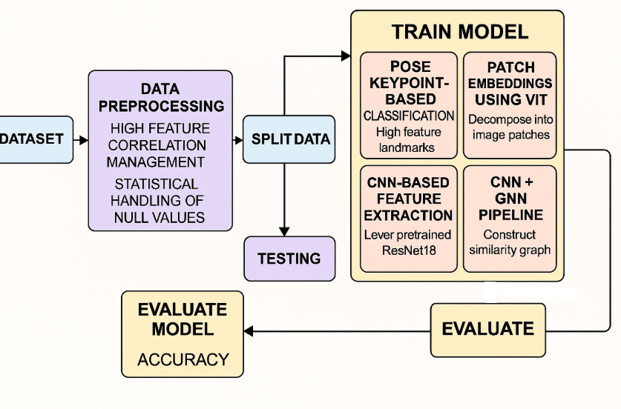
Architecture diagram :

Slide 15
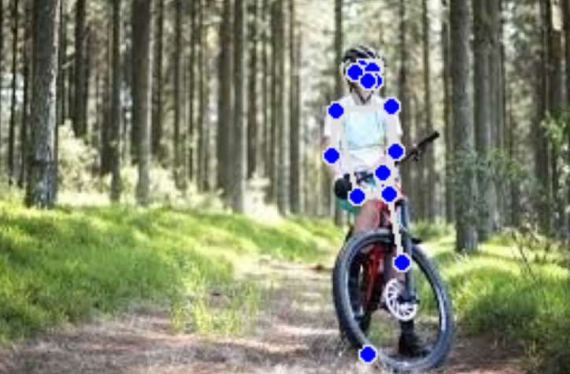
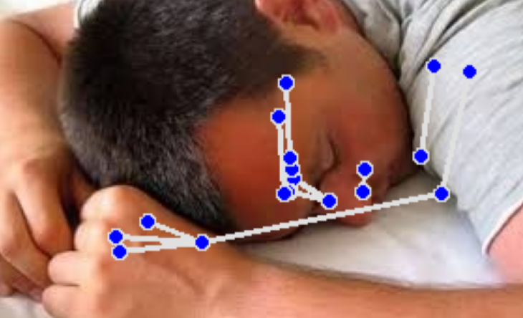
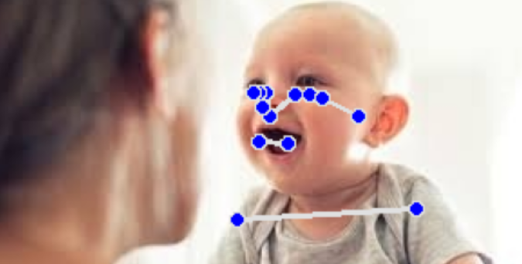
Implementation:
Pose Estimation

Slide 16
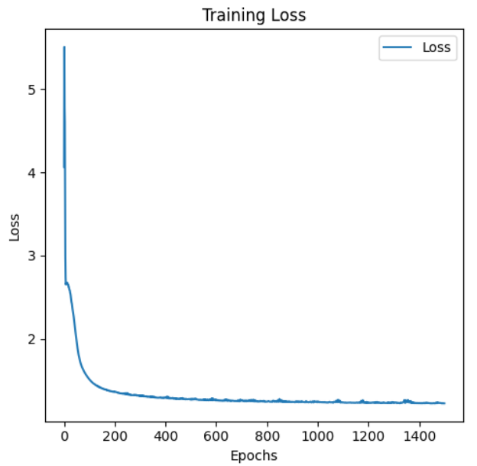
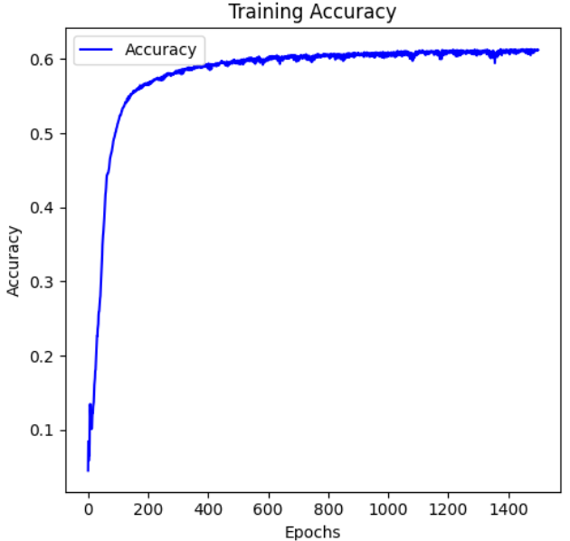
CNN Features (ResNet18) + GCN

Slide 17
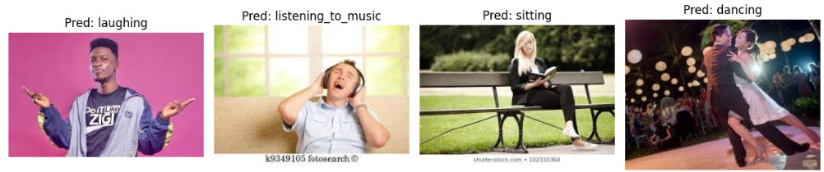
CNN Features (ResNet18) + GCN
Output

Slide 18
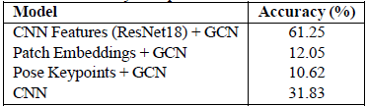
Results:
Human Action Recognition using GCN
1. CNN Features (ResNet18) + GCN (Best Performing Model) → Accuracy: 61.25%
2. Patch Embeddings + GCN → Accuracy: 12.05% → Limited semantic context in fixed spatial partitions
3. Pose Keypoints + GCN → Accuracy: 10.62% → Performance impacted by missing/inconsistent keypoints
4. Standalone CNN (ResNet18) → Accuracy: 31.83% → Lower than CNN-GCN, highlighting the advantage of
relational modeling

Slide 19

Website :

Slide 20
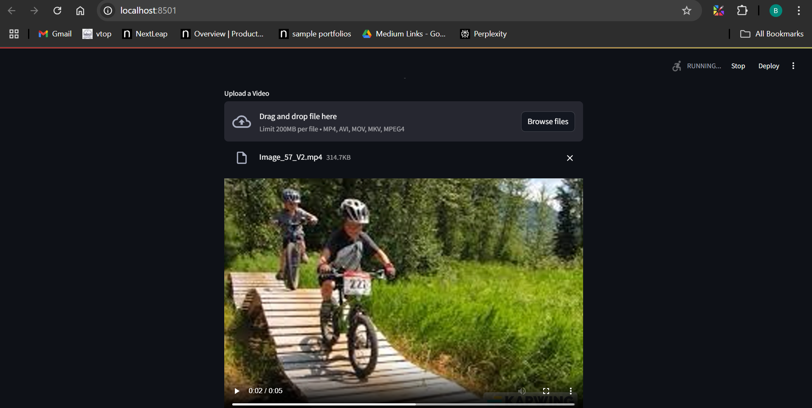

Slide 21
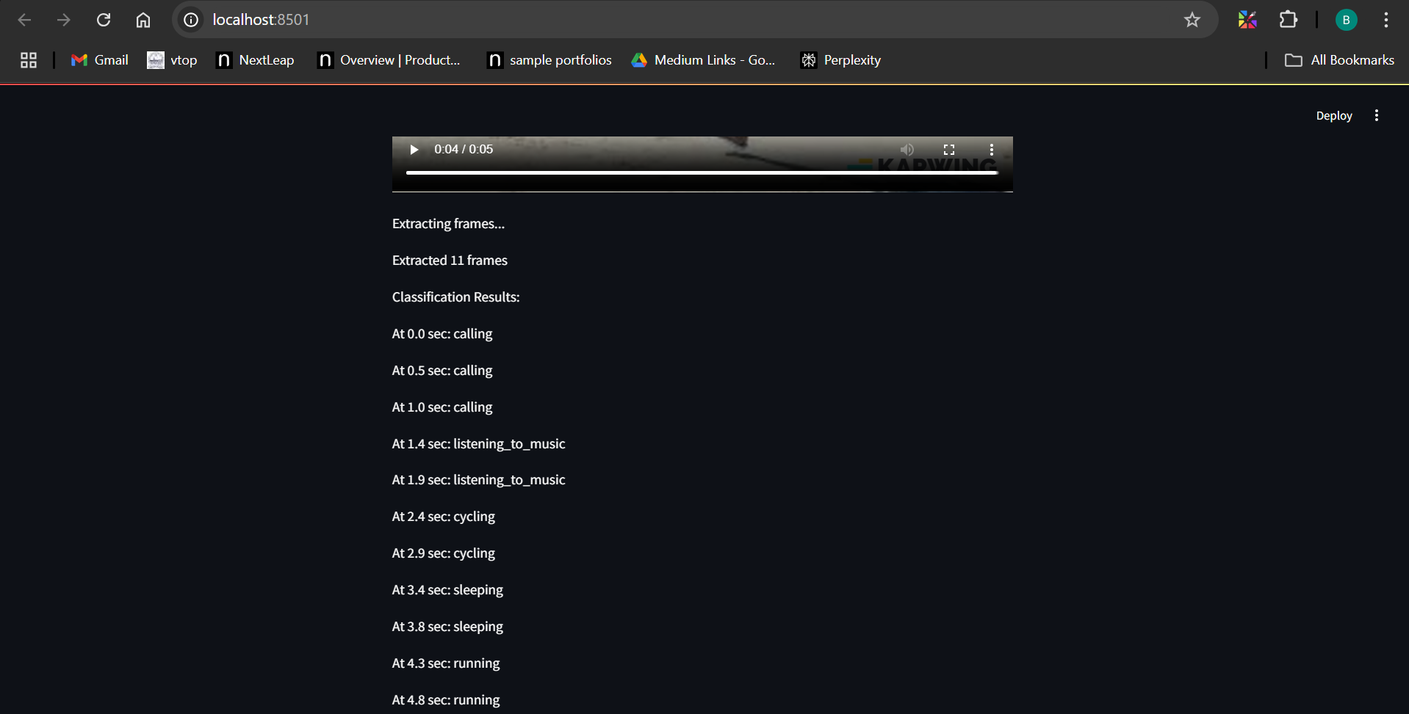

Slide 22
References :
1. S. Cristina, V. Despotovic, R. Pérez-Rodríguez and S. Aleksic, "Audio- and Video-Based Human Activity Recognition Systems in Healthcare,"
in IEEE Access, vol. 12, pp. 8230-8245, 2024, doi: 10.1109/ACCESS.2024.3353138.
2. W. Lin et al., "Unsupervised Video-Based Action Recognition With Imagining Motion and Perceiving Appearance," in IEEE Transactions on Circuits and Systems for Video Technology, vol. 33, no. 5, pp. 2245-2258, May 2023, doi: 10.1109/TCSVT.2022.3221280.
3. Yin, H., Sinnott, R.O. & Jayaputera, G.T. A survey of video-based human action recognition in team sports. Artif Intell Rev 57, 293 (2024). https://doi.org/10.1007/s10462-024-10934-9
4. Kumar, P., Chauhan, S. & Awasthi, L.K. Human Activity Recognition (HAR) Using Deep Learning: Review, Methodologies, Progress and Future Research Directions. Arch Computat Methods Eng 31, 179–219 (2024). https://doi.org/10.1007/s11831-023-09986-x
5. W. Qi, X. Xu, K. Qian, B. W. Schuller, G. Fortino and A. Aliverti, "A Review of AIoT-based Human Activity Recognition: From Application to Technique," in IEEE Journal of Biomedical and Health Informatics, doi: 10.1109/JBHI.2024.3406737.
6. Kumar, R., Kumar, S. A survey on intelligent human action recognition techniques. Multimed Tools Appl 83, 52653–52709 (2024). https://doi.org/10.1007/s11042-023-17529-6
7. Bhola, G., Vishwakarma, D.K. A review of vision-based indoor HAR: state-of-the-art, challenges, and future prospects. Multimed Tools Appl 83, 1965–2005 (2024). https://doi.org/10.1007/s11042-023-15443-5
8 . M. Toshpulatov, W. Lee, S. Lee, H. Yoon and U. Kang, "DDC3N: Doppler-Driven Convolutional 3D Network for Human Action Recognition," in IEEE Access, vol. 12, pp. 93546-93567, 2024, doi: 10.1109/ACCESS.2024.3422428.
9. V. Pandey, T. Gulvi, S. Waghmare, P. Dalvi, R. Kesarkar and D. Dayal, "To Build and Evaluate Irregular Human Activity Detection System Using Deep CNN-LSTM Methodology," 2024 International Conference on Advances in Computing Research on Science Engineering and Technology (ACROSET), Indore, India, 2024, pp. 1-6, doi: 10.1109/ACROSET62108.2024.10743555.
10. S. Jiang, H. Zhang, Y. Qi and Q. Liu, "Spatial-Temporal Interleaved Network for Efficient Action Recognition," in IEEE Transactions on Industrial Informatics, vol. 21, no. 1, pp. 178-187, Jan. 2025, doi: 10.1109/TII.2024.3450021.

Slide 23
References :
11 . N. A. Tu, N. Aikyn, N. Makhanov, A. Abu, K. -S. Wong and M. -H. Lee, "Benchmarking Federated Few-Shot Learning for Video-Based Action Recognition," in IEEE Access, vol. 12, pp. 193141-193164, 2024, doi: 10.1109/ACCESS.2024.3519254.
12. S. Kumawat, T. Okawara, M. Yoshida, H. Nagahara and Y. Yagi, "Action Recognition From a Single Coded Image," in IEEE Transactions on Pattern Analysis and Machine Intelligence, vol. 45, no. 4, pp. 4109-4121, 1 April 2023, doi: 10.1109/TPAMI.2022.3196350
13. Z. Chen, L. Teng, L. Xu, J. Yu and J. Liang, "MP-HAR: A Novel Motion-Powered Real-Time Human Activity Recognition System," in IEEE Internet of Things Journal, vol. 11, no. 5, pp. 7652-7663, 1 March1, 2024, doi: 10.1109/JIOT.2023.3315789.
14. D. Thakur, A. Guzzo and G. Fortino, "Intelligent Adaptive Real-Time Monitoring and Recognition System for Human Activities," in IEEE Transactions on Industrial Informatics, vol. 20, no. 11, pp. 13212-13222, Nov. 2024, doi: 10.1109/TII.2024.3431628.
15. W. Jiao and C. Zhang, "An Efficient Human Activity Recognition System Using WiFi Channel State Information," in IEEE Systems Journal, vol. 17, no. 4, pp. 6687-6690, Dec. 2023, doi: 10.1109/JSYST.2023.3293482
16. F. Alam, P. Pławiak, A. Almaghthawi, M. Reza Chalak Qazani, S. Mohanty and a. Roohallah Alizadehsani, "NeuroHAR: A Neuroevolutionary Method for Human Activity Recognition (HAR) for Health Monitoring," in IEEE Access, vol. 12, pp. 112232-112248, 2024, doi: 10.1109/ACCESS.2024.3441108.

